Slide 1

Green University of Bangladesh
Department of Computer Science and Engineering (CSE)
Faculty of Sciences and Engineering
Semester: Spring, Year: 2022, B.Sc. in CSE (DAY)
LAB REPORT NO # 02
Course Title: Structured Programming Lab
Course Code: CSE 104 Section: CSE 213 - DB (PC)
Lab Experiment Name(s):
Lab Report for Performing Basic Algebraic Operations (Determining - Area, Temperature, Sum and Average) Using C.
Student Details
Name | ID
Md. Shahidul Islam Prodhan | 213902017
Lab Date: 12 February 2022
Submission Date: 18 February 2022
Course Teacher’s Name: Md. Solaiman Mia, Assistant Professor.
[For Teacher’s use only: Don’t write anything inside this box]
Lab Report Status
Marks: | Signature:
Comments: | Date:

Slide 2
1. TITLE OF THE LAB EXPERIMENT
Lab Report for Performing Basic Algebraic Operations (Determining - Area, Temperature, Sum and Average) Using C.
2. OBJECTIVES
In the first problem, one side of a square is defined and then we simply multiply with itself. Then, in the second and third problems are quite similar, as it is an algebraic expression. For second problem, we take user input in Celsius scale and show the result in Fahrenheit scale, and for the third problem we take user input in Fahrenheit scale and show the result in Celsius scale. Last problem, it is a simple total sum from user input for five different subjects and we simply divide by the number of the total sum for average.
3. PROCEDURE
Problem 1: Area of a Square, take length of one side as user input.
At first write the basic structure of C program. Then inside main function we declare two variables x and area and then store integer value. We take one side of a square from user using scanf function and multiply with itself, as we know area of a square is x^2. And after that we can show the area of the square using “printf” function.
Problem 2: Temperature in °Celsius and convert it into °Fahrenheit.
At first, we declare three variables C, F, Result - using float function because the result can be decimal. Then we take the user input in Celsius scale using scanf function. Now, we can write F=(9C+160)/5 this equation to show result in Fahrenheit scale. Lastly, we can show result in Fahrenheit scale for example: 42°C→107.599998°F .
Problem 3: Temperature in Fahrenheit(°F) and convert it into Celsius(°C).
Just like Problem 3, we declare three variables C, F, Result - using float function because the result can be decimal. Then we take the user input in Fahrenheit scale using scanf function. Now, we can write C=(F-32)/1.8 this equation to show result in Celsius scale. Lastly, we can show result in Celsius scale for example: 98°F→36.666668°C.
Problem 4: Marks of five subjects and calculate total and average marks.
Firstly, we declare required variables for the subjects as well as for total marks and average marks using float function as the results can be in decimal numbers. We take 5 individual subject marks as input for each of the subjects from user with the help of scanf function. Then we get the total marks for 5 subjects and show the result using printf function. Then we take the total marks and divide it by 5, the number of subjects for the average value. Lastly, we get the average marks of the subjects using printf function.

Slide 3
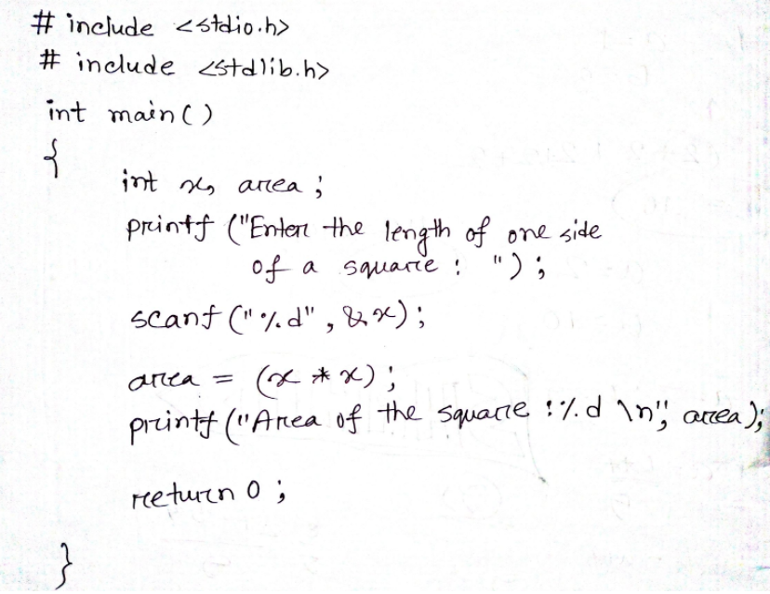
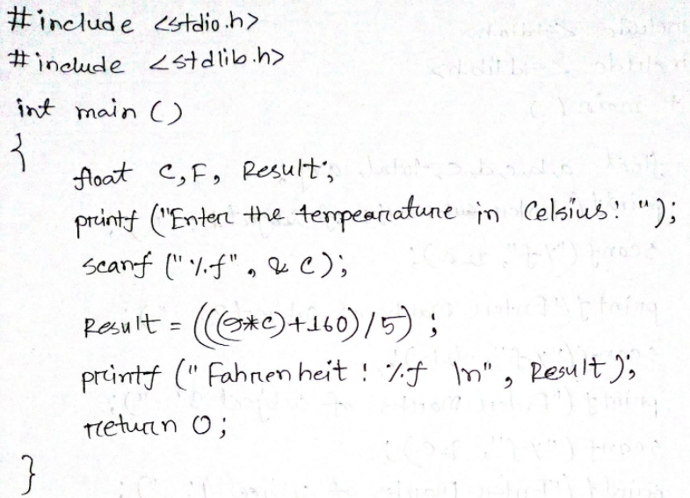
4. IMPLEMENTATION
Problem 1: Area of a Square, take length of one side as user input.
Problem 2: Temperature in °Celsius and convert it into °Fahrenheit.

Slide 4
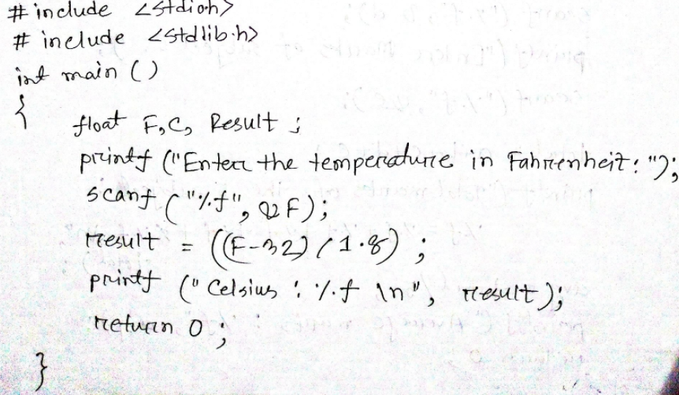
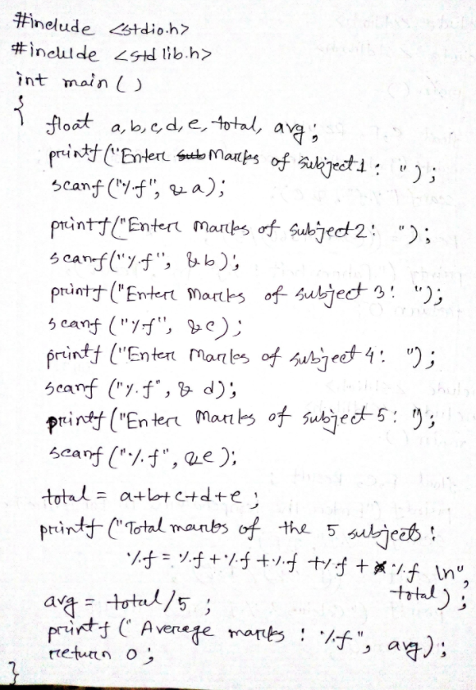
Problem 3: Temperature in Fahrenheit(°F) and convert it into Celsius(°C).
Problem 4:Marks of five subjects and calculate total and average marks.

Slide 5
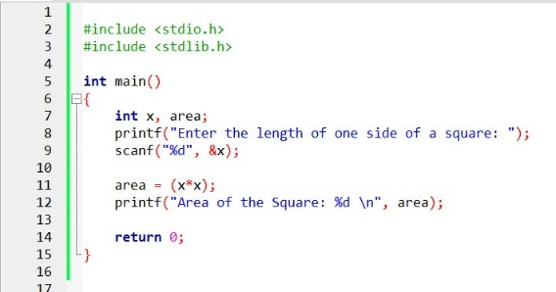
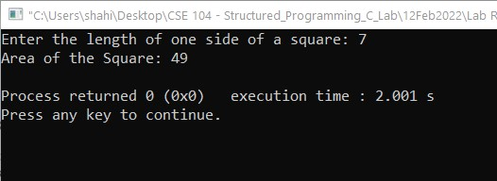
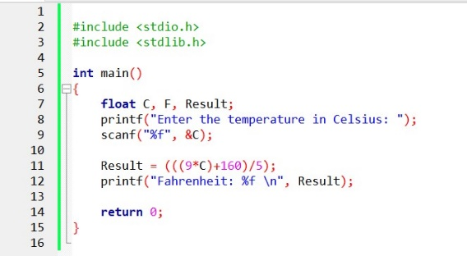
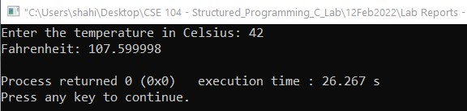
5. TEST RESULT
Problem 1:Area of a Square, take length of one side as user input.
Problem 2: Temperature in °Celsius and convert it into °Fahrenheit.

Slide 6
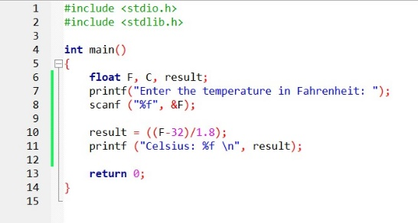
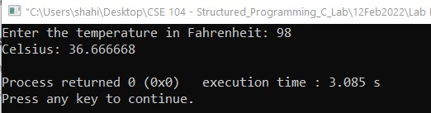
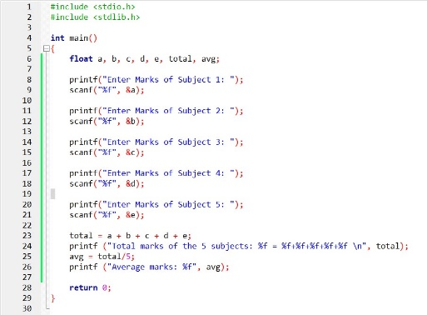
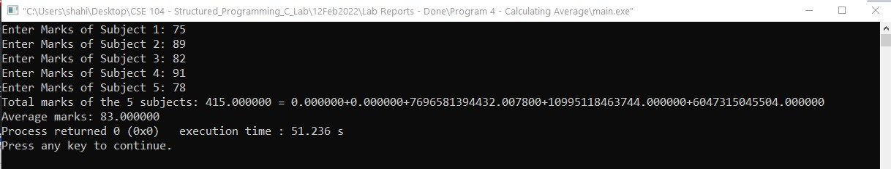
Problem 3: Temperature in Fahrenheit(°F) and convert it into Celsius(°C).
Problem 4: Marks of five subjects and calculate total and average marks.

Slide 7
6. ANALYSIS AND DISCUSSION
In first problem of determining the area of a square x^2 we get the area result. In second and third problem, the procedure is very much similar to each other as it is an equation solving problem where we put Celsius value to get Fahrenheit value and vice-versa. The fourth and last problem is nothing much but of summation of five different value and dividing them with the number of value which gives us the total marks of the subjects and average marks for the subjects.
We have solved those problems using CodeBlocks IDE and there were no errors occurred. And we can successfully print the output of those problems.
We have faced a little bit difficulty while Fahrenheit to Celsius in the equation showing the wrong results but then we have passed errors and corrected our program and it gives correct result.
Solving these 4 problems, we have learned how to determine area by adding/multiplying both any integer and floating number and calculating average of numbers as well as solving algebraic equation using C.
7. SUMMARY
From the given experiments, we have learned the very basic implementation of C language in order to do some basic calculation such as area of rectangle or square, conversion of temperature value as algebraic expression and perform some basic summation and average calculation using “printf” function and “scanf” functions in C.

